Slide 1

Group 23
Alexandre Sachs
Charles Descoust Kellian Cipierre
Raphaël Guy

Slide 2
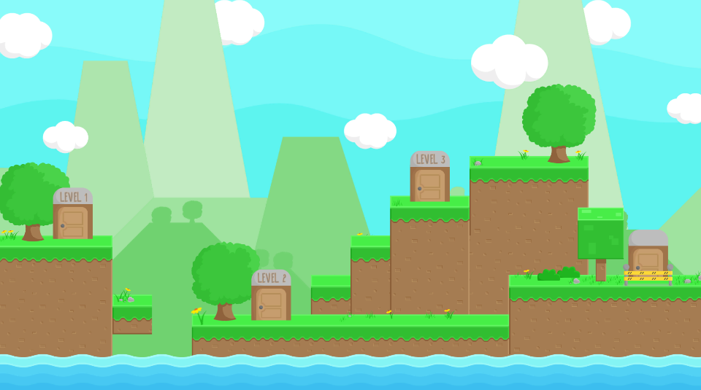

2D
Platformer
Die and Retry

Slide 3

Rewards

Slide 4

Lifes

Slide 5


Objectives

Slide 6



Enemies

Slide 7
Charles Descoust
Inventory
Introduction
Level Selection

Slide 8
Alexandre Sachs
Game UI
Player
Level1

Slide 9
Kellian Cipierre
Sound
Enemies
Level2

Slide 10
Raphaël Guy
Game Over
Level3
Level4

Slide 11
Demonstration

Slide 12


Slide 13
Group 23
Alexandre Sachs
Charles Descoust Kellian Cipierre
Raphaël Guy

